Slide 1
DBMS Architecture
Lecture 2

Slide 2
DBMS Architecture
The DBMS design depends upon its architecture.
- Client Server Architecture
- Distributed System
DBMS architecture depends upon how users are connected to the database to get their request done.

Slide 3
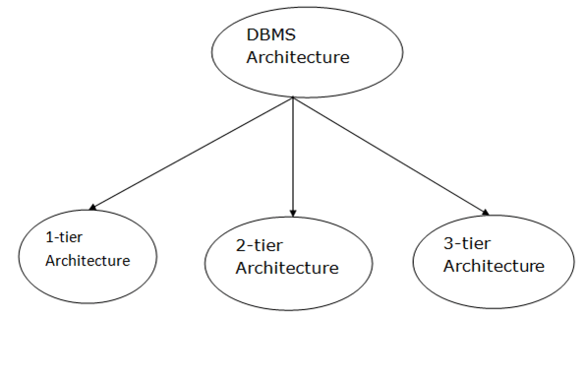
Types of DBMS Architecture
Database architecture can be seen as a single tier or multi-tier. But
logically, database architecture is of two types like: 2-tier architecture and 3-tier architecture.

Slide 4
1-Tier Architecture
In this architecture, the database is directly available to the user. It means the user can directly sit on the DBMS and uses it.
Any changes done here will directly be done on the database itself. It doesn't provide a handy tool for end users.
The 1-Tier architecture is used for development of the local application, where programmers can directly communicate with the database for the quick response.

Slide 5
2-Tier Architecture
The 2-Tier architecture is same as basic client-server. In the two-tier architecture, applications on the client end can directly communicate with the database at the server side. For this interaction, API's like: ODBC, JDBC are used.
The user interfaces and application programs are run on the client-side.
The server side is responsible to provide the functionalities like: query processing and transaction management.
To communicate with the DBMS, client-side application establishes a connection with the server side.

Slide 6
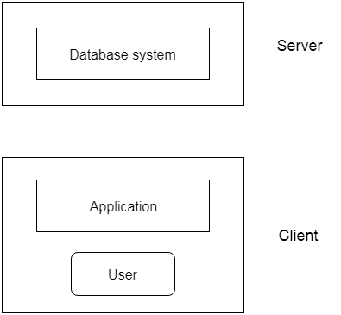
2-Tier Architecture

Slide 7
3-Tier Architecture
The 3-Tier architecture contains another layer between the client and server. In this architecture, client can't directly communicate with the server.
The application on the client-end interacts with an application server which further communicates with the database system.
End user has no idea about the existence of the database beyond the application server. The database also has no idea about any other user beyond the application.
The 3-Tier architecture is used in case of large web application.

Slide 8
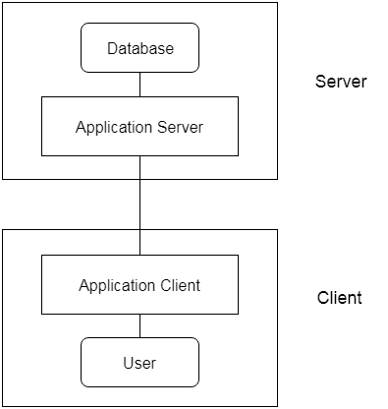
3-Tier Architecture

